Slide 1
CSE322
Formal Languages and Automation Theory
....

Slide 2
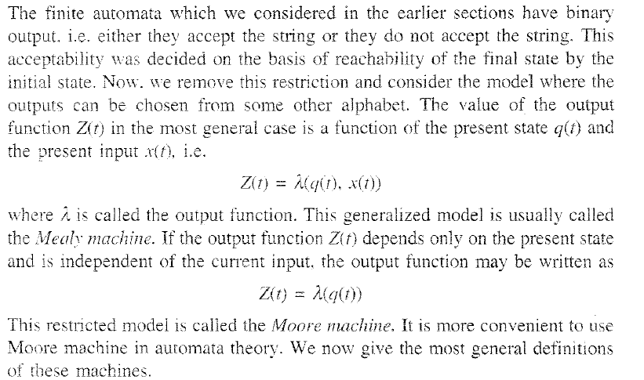
Mealy AND Moore Models

Slide 3
Moore machine
The Automata Moore and Mealy Machine take the input and give the output. There is no final state. There must be a dedicated path for each input from each state, like DFA.
Moore and Mealy machines take an input string (i.e., 11001) and give an output (i.e., aabbab).
Each state of the Moore or Mealy machine gives an output. Output is denoted by the Output symbol.
The output of the Moore machine is always one greater than the input. If the input length is three (i.e., 011), the output length will be four (i.e., aabb). Because the initial state always gives an output without an input.

Slide 4
Formal Definition of Moore Machine
Moore machine can be described by 6 tuples
(Q, q0, ∑, O, δ, λ) where,
Q: a finite set of states
q0: initial state of machine
∑: a finite set of input symbols
O: output alphabet
δ: transition function where Q × ∑ → Q
λ: output function where Q → O
Note: Output depends only on the states of machine.

Slide 5
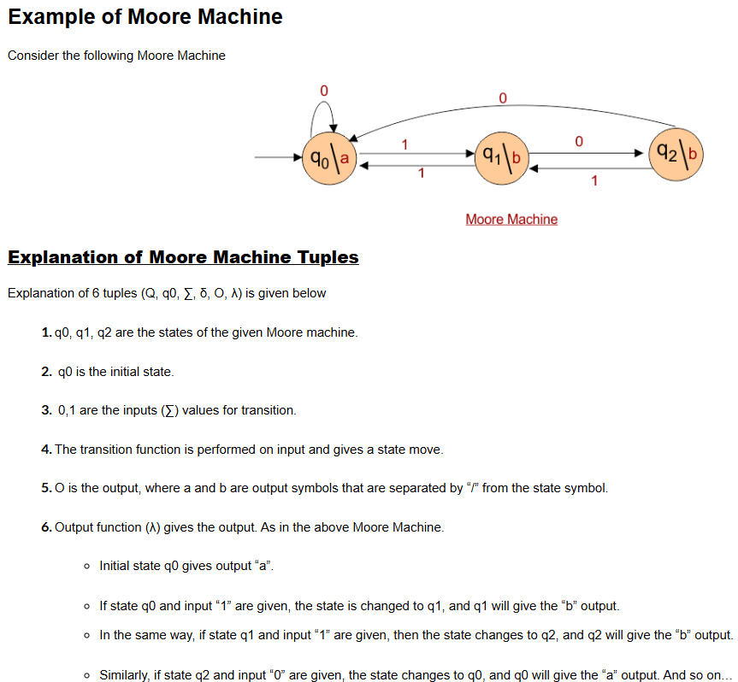

Slide 6
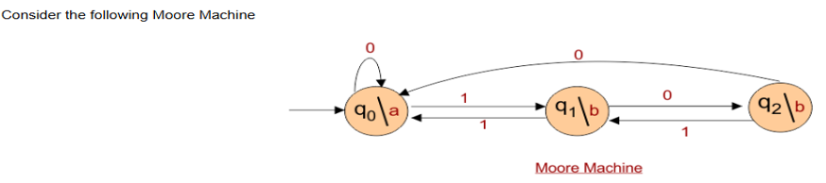
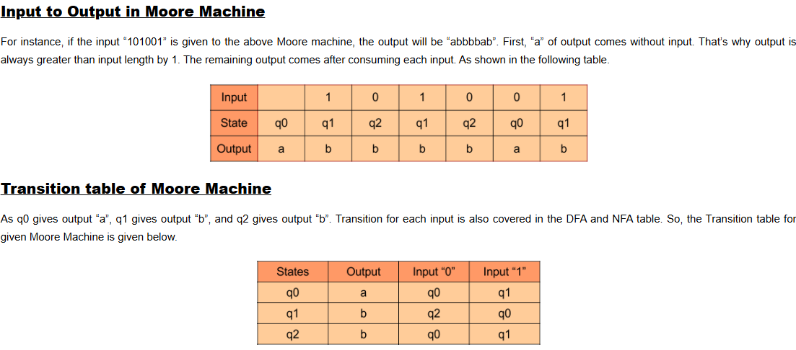

Slide 7
Sample Questions
Moore Machine is an application of:
a) Finite automata without input
b) Finite automata with output
c) Non Finite automata with output
d) None of the mentioned

Slide 8
cont..
For a Moore Machine, Given Input=’101010’, thus the output would be of length:
a) |Input|+1
b) |Input|
c) |Input-1|
d) Cannot be predicted

Slide 9
Mealy Machine
In the Automata Mealy Machine, the output symbol is represented along with the input symbol for each state. Both input and output symbols are separated by /.
In Mealy Machine, the length of the input is always equal to the output. Because In the Mealy Machine, the first output comes by consuming the first input symbol.
Before reaching the next state, output is received immediately as the input is consumed.

Slide 10
Formal definition of Mealy Machine
Mealy Machine can described by 6 tuples
(Q, q0, ∑, O, δ, λ’), where
q0 and q1 are states (Q).
q0 is the initial state.
Input alphabets (∑) are “0” and “1”.
Output alphabets (O) are “a” and “b”.
Transition function (Q×∑→Q) and output function (Q×∑→O)
Note: A mealy machine's output depends on both the present state and the present input.

Slide 11
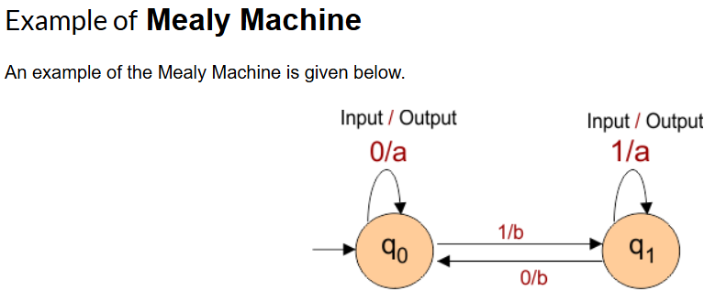
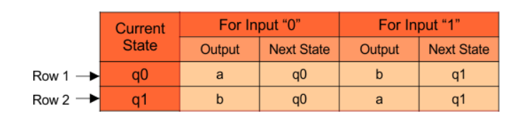
Transition Table in Mealy Machine
Input | 1 | 0 | 0 | 1
State | q₀ | q₁ | q₀ | q₀
Output | b | b | a | b

Slide 12
Sample Questions
In mealy machine, the O/P depends upon?
a) State
b) Previous State
c) State and Input
d) Only Input

Slide 13
cont..
Which of the following is a correct statement?
a) Moore machine has no accepting states
b) Mealy machine has accepting states
c) We can convert Mealy to Moore but not vice versa
d) All of the mentioned

Slide 14
cont..
In mealy machine, the O/P depends upon?
a) State
b) Previous State
c) State and Input
d) Only Input

Slide 15
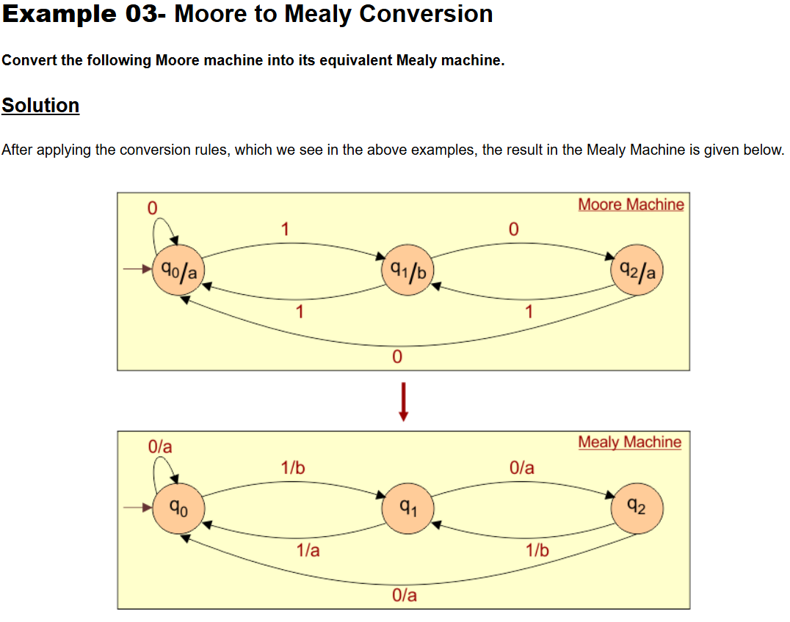
Conversion
Mealy to Moore Machine

Slide 16
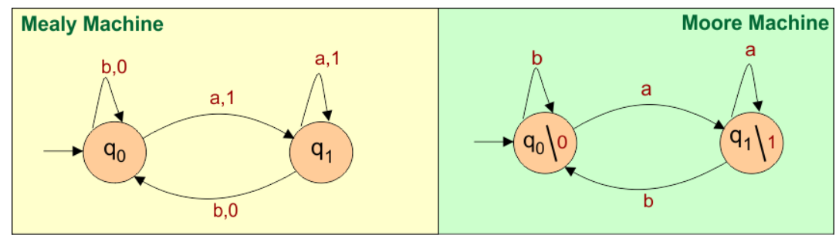
Conversion
Moore to Mealy Machine

